Slide 1

Self-Balancing Cube
Iustinian Serban Bogdan

Slide 2
Contents
Project Overview
01
Methodology
02
System Architecture
03
Control System Design
04
Testing
05
Next Steps
06
Bibliography
07

Slide 3
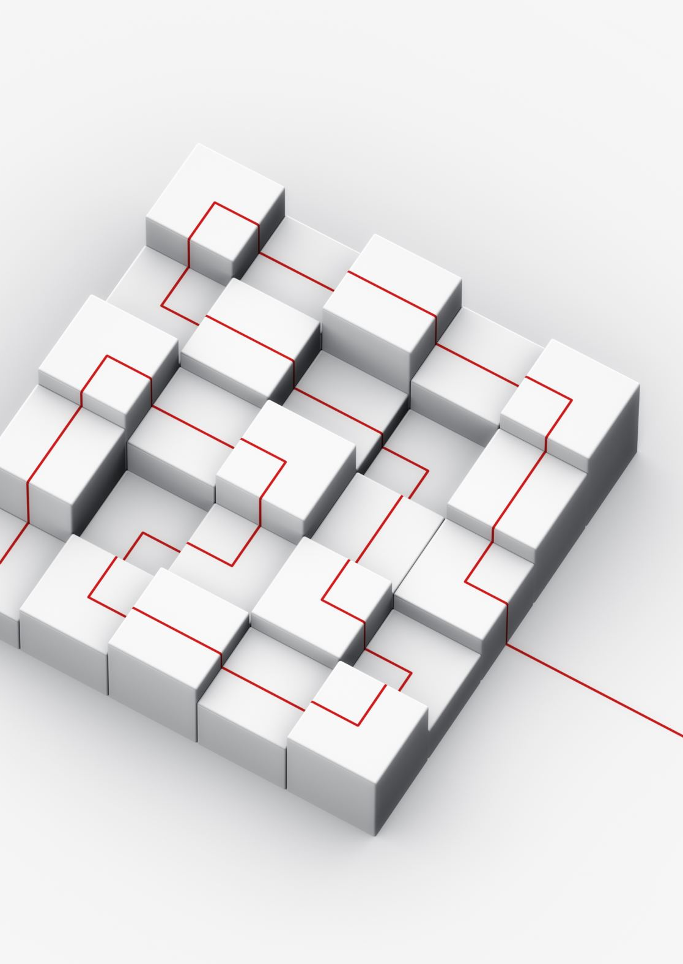
Project Overview
Design and implementation of a self-balancing cube (Cubli) that uses reaction wheels and a gyroscope to maintain balance on one of its edges or corners.
Objectives:
Design and assemble a medium-scale Cubli. ✅
Implement a control system to balance the Cubli on its edge using feedback from sensors. ⁉️
Tune and optimize the PID controllers to ensure stability and fast recovery from perturbations. ✅
Demonstrate the cube’s ability to balance autonomously after disturbances. ❌

Slide 4
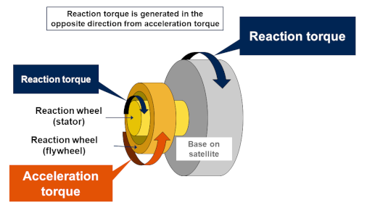
Methodology – Reaction Wheels
A reaction wheel is a spinning mass mounted inside the cube. When the motor changes the wheel’s rotational speed, the cube experiences an equal and opposite torque (due to the conservation of angular momentum).
Accelerating a reaction wheel clockwise applies a counterclockwise torque to the cube.
Decelerating or braking the wheel applies torque in the opposite direction.

Slide 5
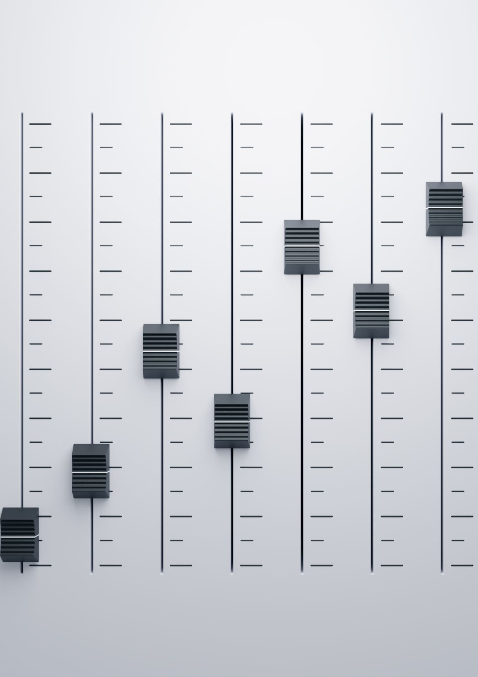

Methodology – PID Controller
A PID controller is a widely used feedback control mechanism that calculates an error value between a desired setpoint and a measured process variable and then applies a corrective action to minimize that error over time.
Proportional (P): Corrects the error in proportion to its current size.
Integral (I): Corrects accumulated past errors by integrating over time.
Derivative (D): Predicts future errors by calculating the rate of change.
$$u\left(t\right)=Kp​⋅e\left(t\right)+Ki​⋅\int{e}\left(t\right)dt+Kd​⋅dtde\left(t\right)$$

Slide 6

Methodology – PID Controller
A PID controller is a widely used feedback control mechanism that calculates an error value between a desired setpoint and a measured process variable and then applies a corrective action to minimize that error over time.
Proportional (P): Corrects the error in proportion to its current size. ✅
Integral (I): Corrects accumulated past errors by integrating over time. ✅
Derivative (D): Predicts future errors by calculating the rate of change. ❌
$$u\left(t\right)=Kp​⋅e\left(t\right)+Ki​⋅\int{e}\left(t\right)dt+Kd​⋅dtde\left(t\right)$$

Slide 7
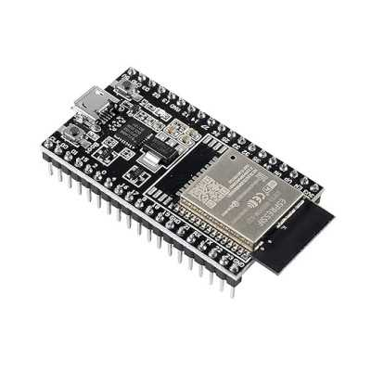
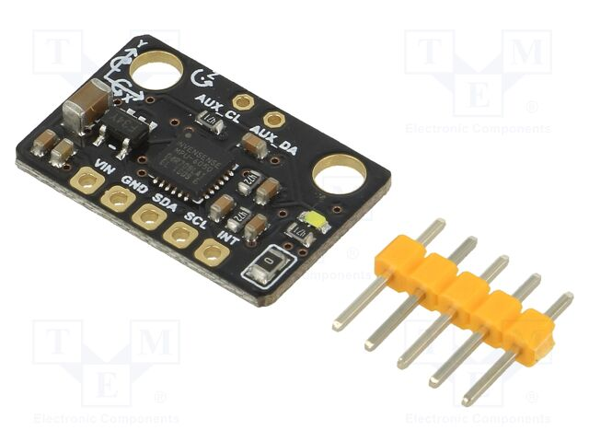
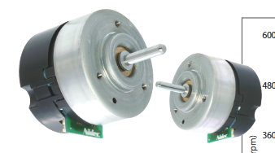
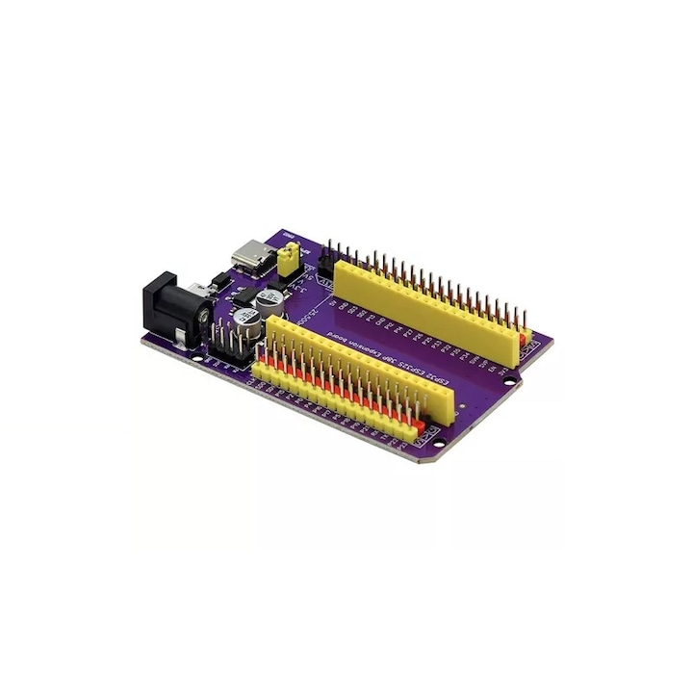
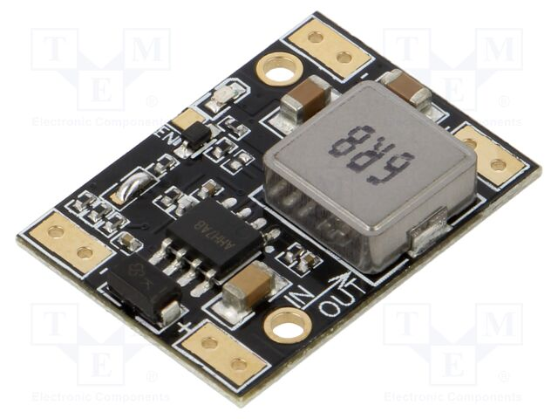
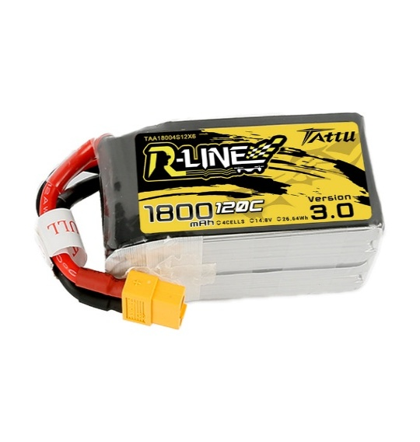
System Architecture – Electronic Components
ESP32-DevKitC 38 Pins
DF-SEN0142 IMU 6DOF
Nidec 24H Motors
Expansion Board for ESP32
DF-DFR1015 Buck Converter
1800mAh 14.8V LiPo Battery

Slide 8
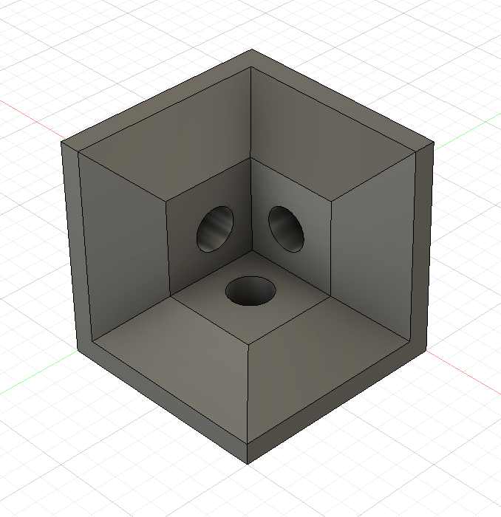
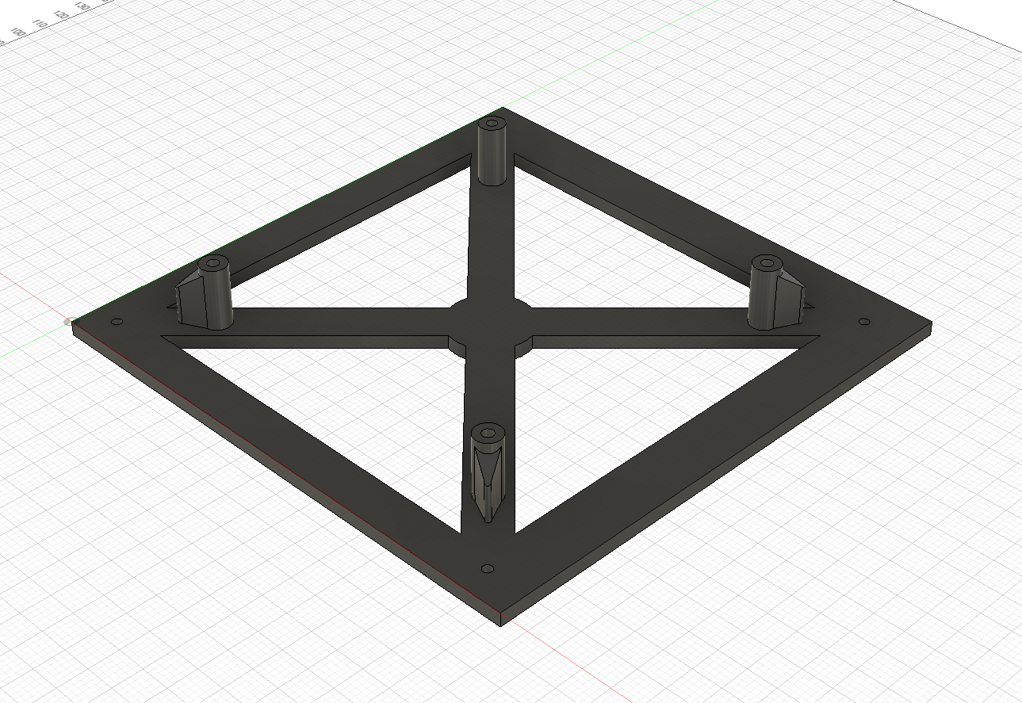
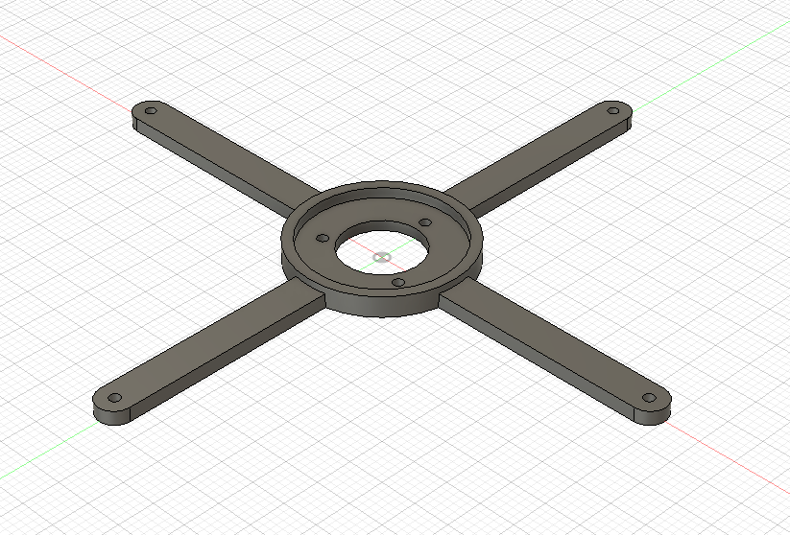
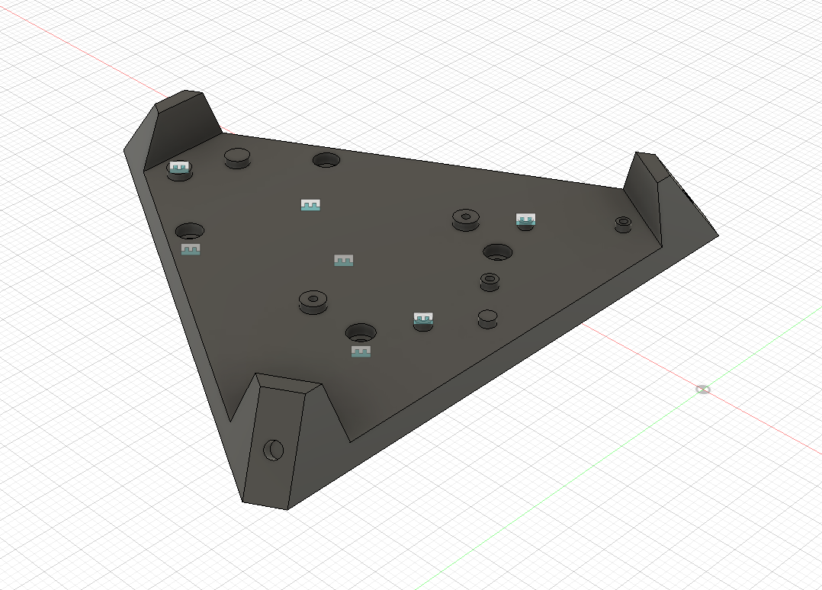
System Architecture – Mechanical
Custom Model in Fusion 360
3D Printed Parts in PLA
COTS Components
Corner Piece
Plate with Mounting Holes
Motor Bracket
Electronics Support

Slide 9
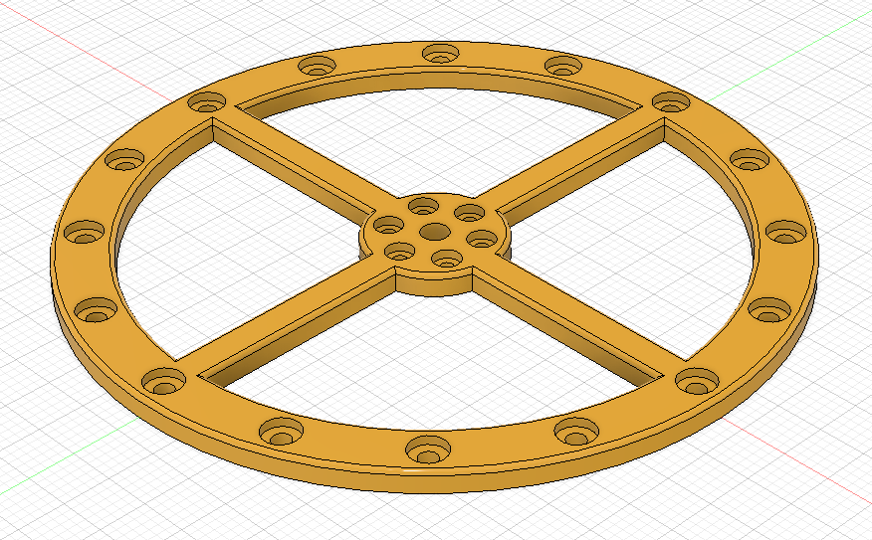
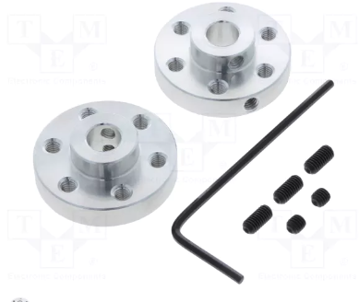
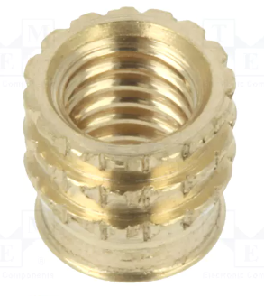
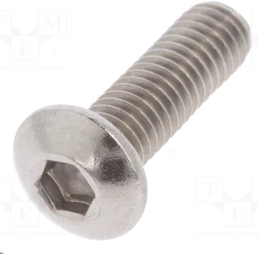
System Architecture – Mechanical
Reaction Wheel
Aluminum Mounting Hub
Brass Inserts
M3/M4 Screws and Nuts

Slide 10
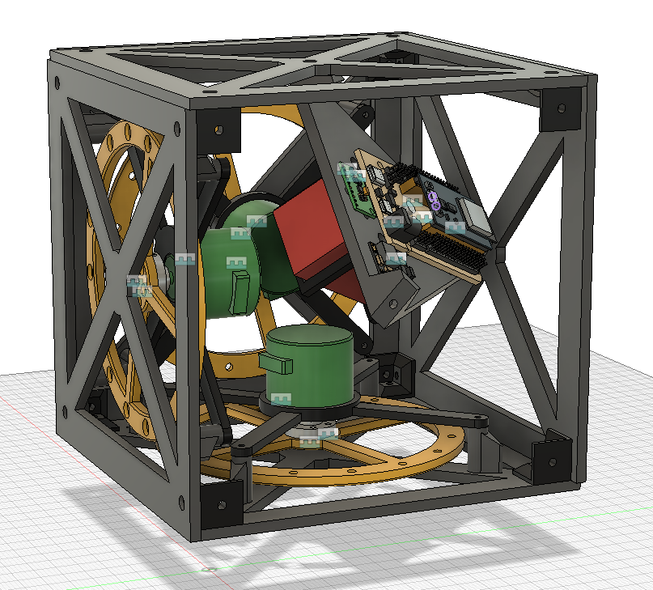
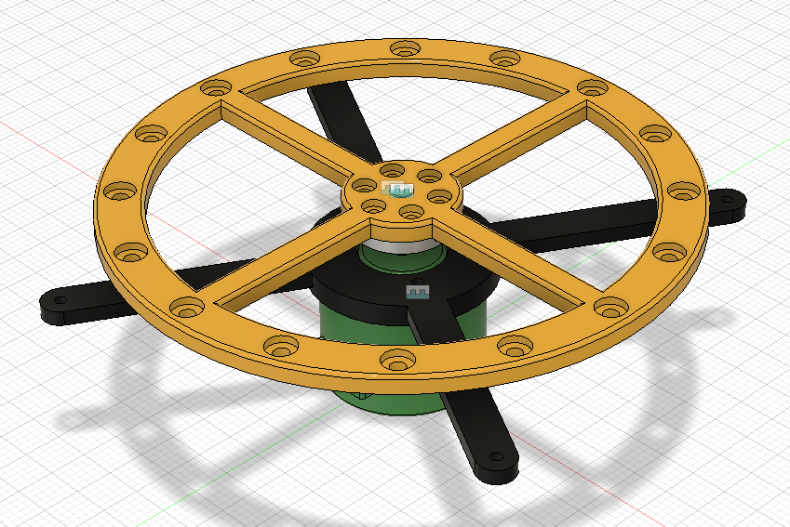
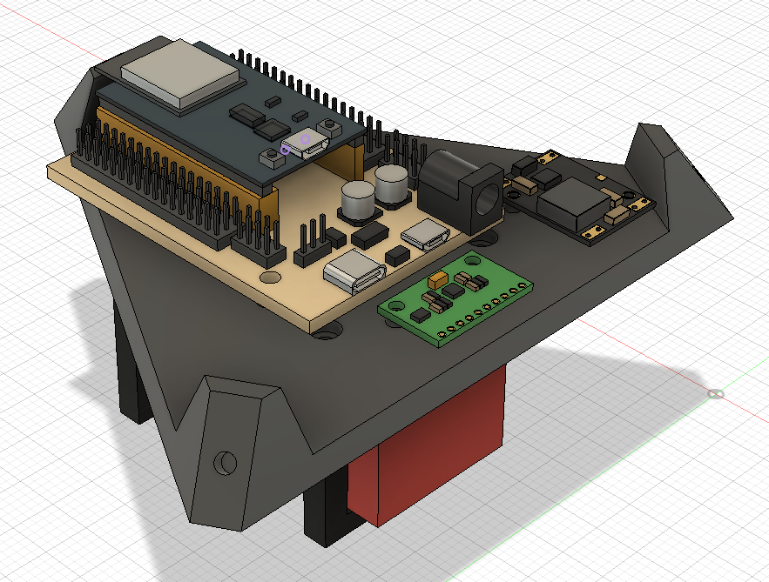
System Architecture – Assembly
Motor Assembly
Electronics Assembly
Main Assembly

Slide 11
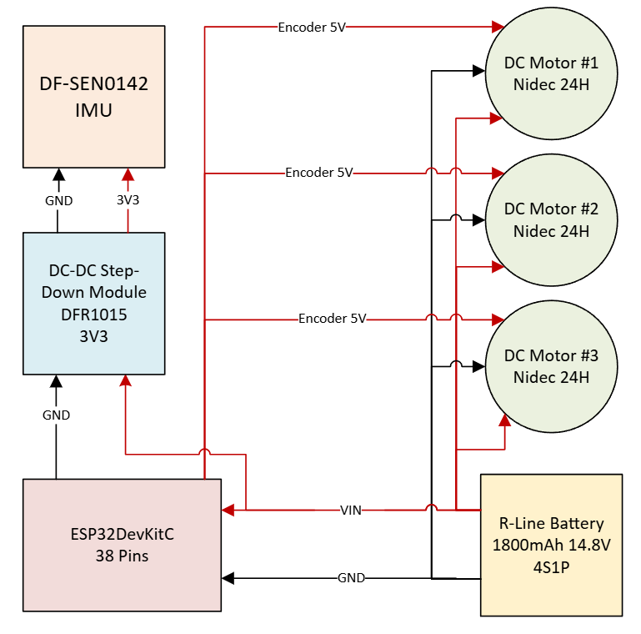
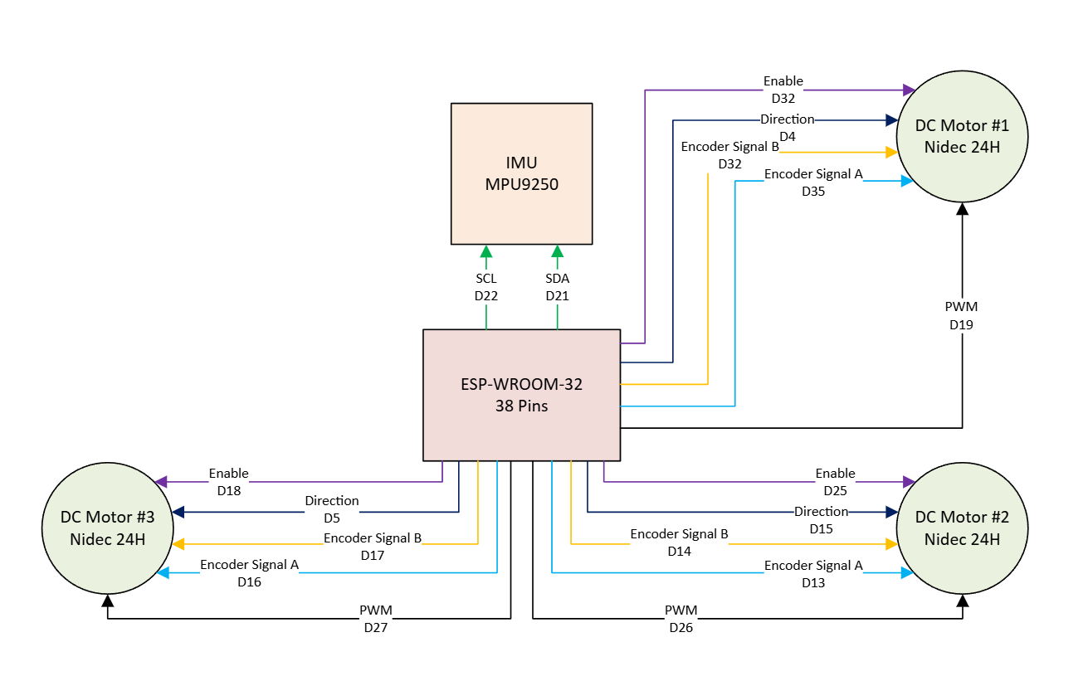
System Architecture – Connection Diagrams
Power Lines
Data Lines

Slide 12
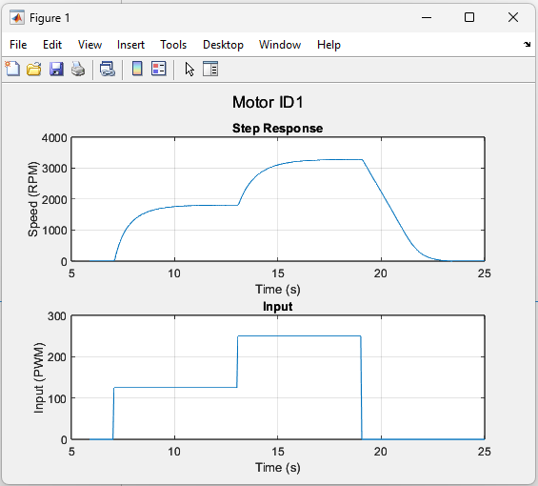
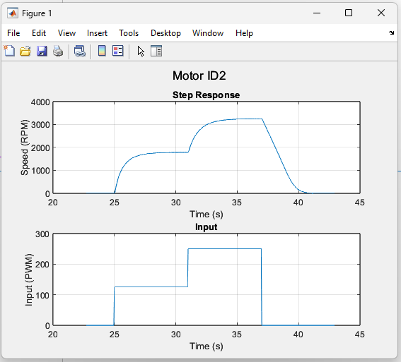
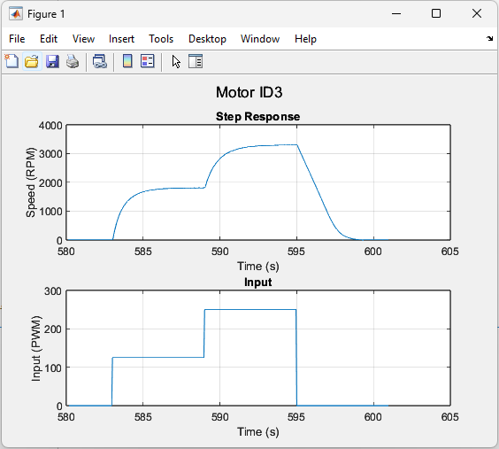
Control System Design – Motor Data Acquisition
Data Lines

Slide 13
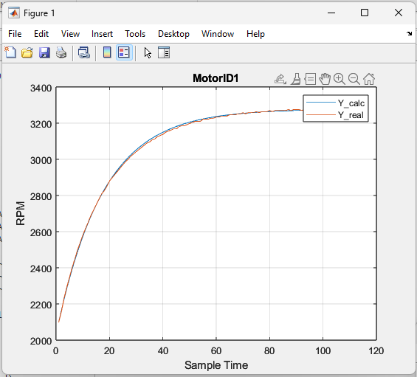
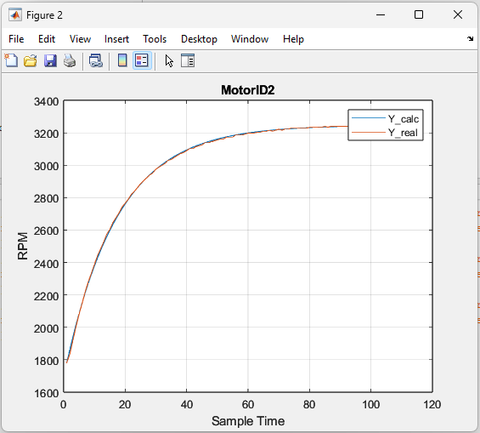
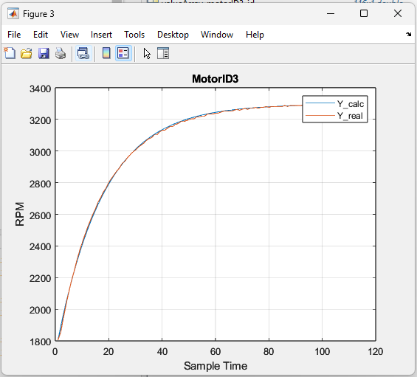
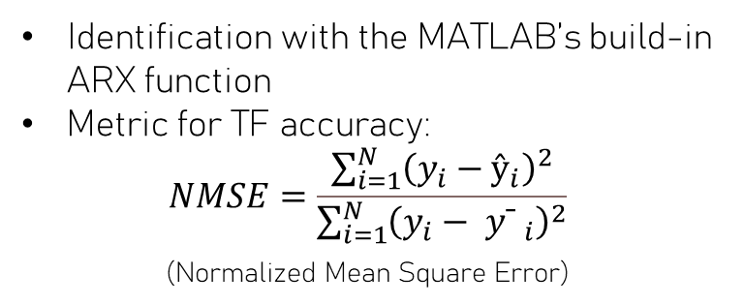
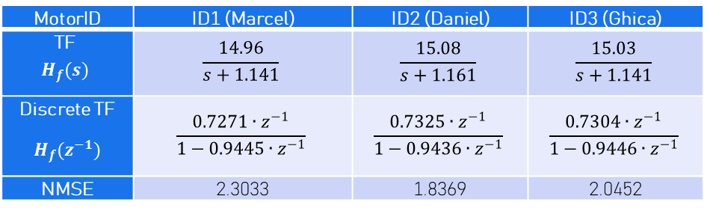
Control System Design – Transfer Functions
MotorID | ID1 (Marcel) | ID2 (Daniel) | ID3 (Ghica)
TF $$H_{f}(s)$$ | $$\frac{14.96}{s+1.141}$$ | $$\frac{15.08}{s+1.161}$$ | $$\frac{15.03}{s+1.141}$$
Discrete TF $$H_{f}(z^{−1})$$ | $$\frac{0.7271∙z^{−1}}{1−0.9445∙z^{−1}}$$ | $$\frac{0.7325∙z^{−1}}{1−0.9436∙z^{−1}}$$ | $$\frac{0.7304∙z^{−1}}{1−0.9446∙z^{−1}}$$
NMSE | 2.3033 | 1.8369 | 2.0452
Identification with the MATLAB’s build-in ARX function
Metric for TF accuracy:
$$NMSE=\frac{\sum_{i=1}^{N}{{\left(y_{i}​−{ŷ​}_{i}​\right)}^{2}}}{\sum_{i=1}^{N}{{\left(y_{i}​−{ yˉ​ ​}_{i}​\right)}^{2}}}$$
(Normalized Mean Square Error)

Slide 14
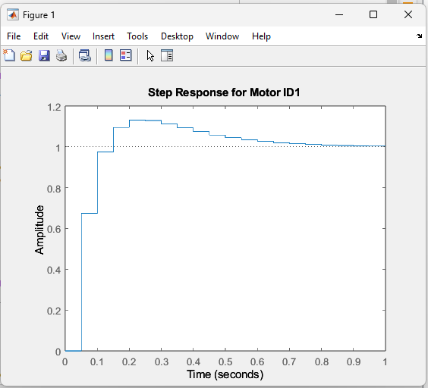
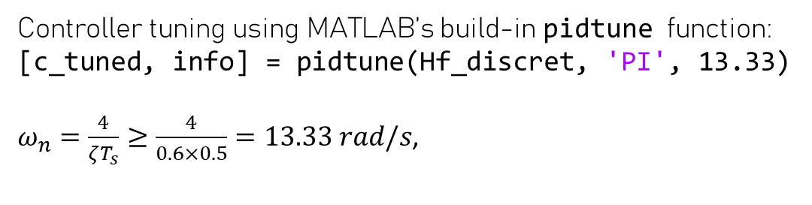
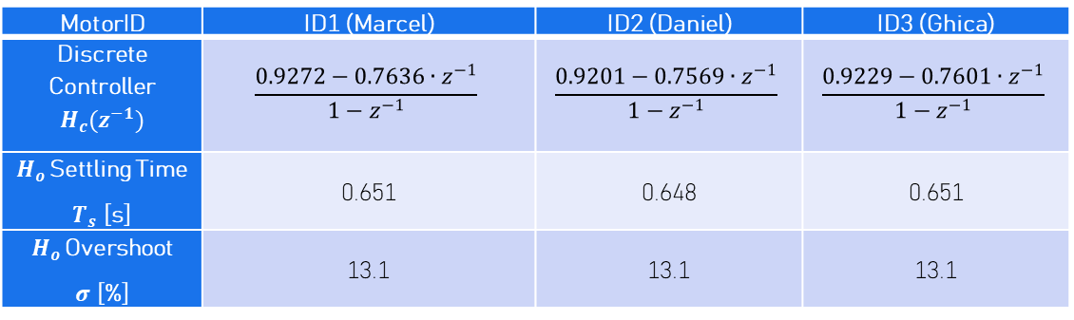
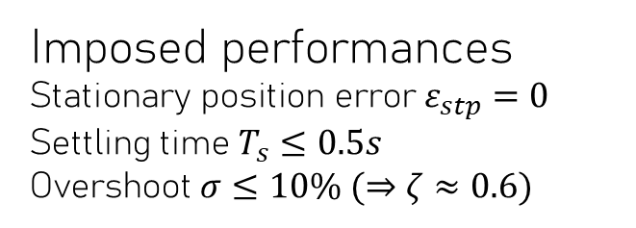
Control System Design – PI Tuning
MotorID | ID1 (Marcel) | ID2 (Daniel) | ID3 (Ghica)
Discrete Controller $$H_{c}(z^{−1})$$ | $$\frac{0.9272−0.7636∙z^{−1}}{1−z^{−1}}$$ | $$\frac{0.9201−0.7569∙z^{−1}}{1−z^{−1}}$$ | $$\frac{0.9229−0.7601∙z^{−1}}{1−z^{−1}}$$
$H_{o }$Settling Time $T_{s}$ [s] | 0.651 | 0.648 | 0.651
$H_{o }$Overshoot $σ$ [%] | 13.1 | 13.1 | 13.1
Imposed performances
$$\text{S}\text{tationary} \text{position} \text{error} ε_{stp}=0$$
Settling time $T_{s}≤0.5s$
Overshoot $σ≤10\% (⇒ζ≈0.6)$
Controller tuning using MATLAB’s build-in pidtune function:
[c_tuned, info] = pidtune(Hf_discret, 'PI', 13.33)
$ω_{n}=\frac{4}{ζT_{s}}≥\frac{4}{0.6×0.5}=13.33 rad/s$,

Slide 15
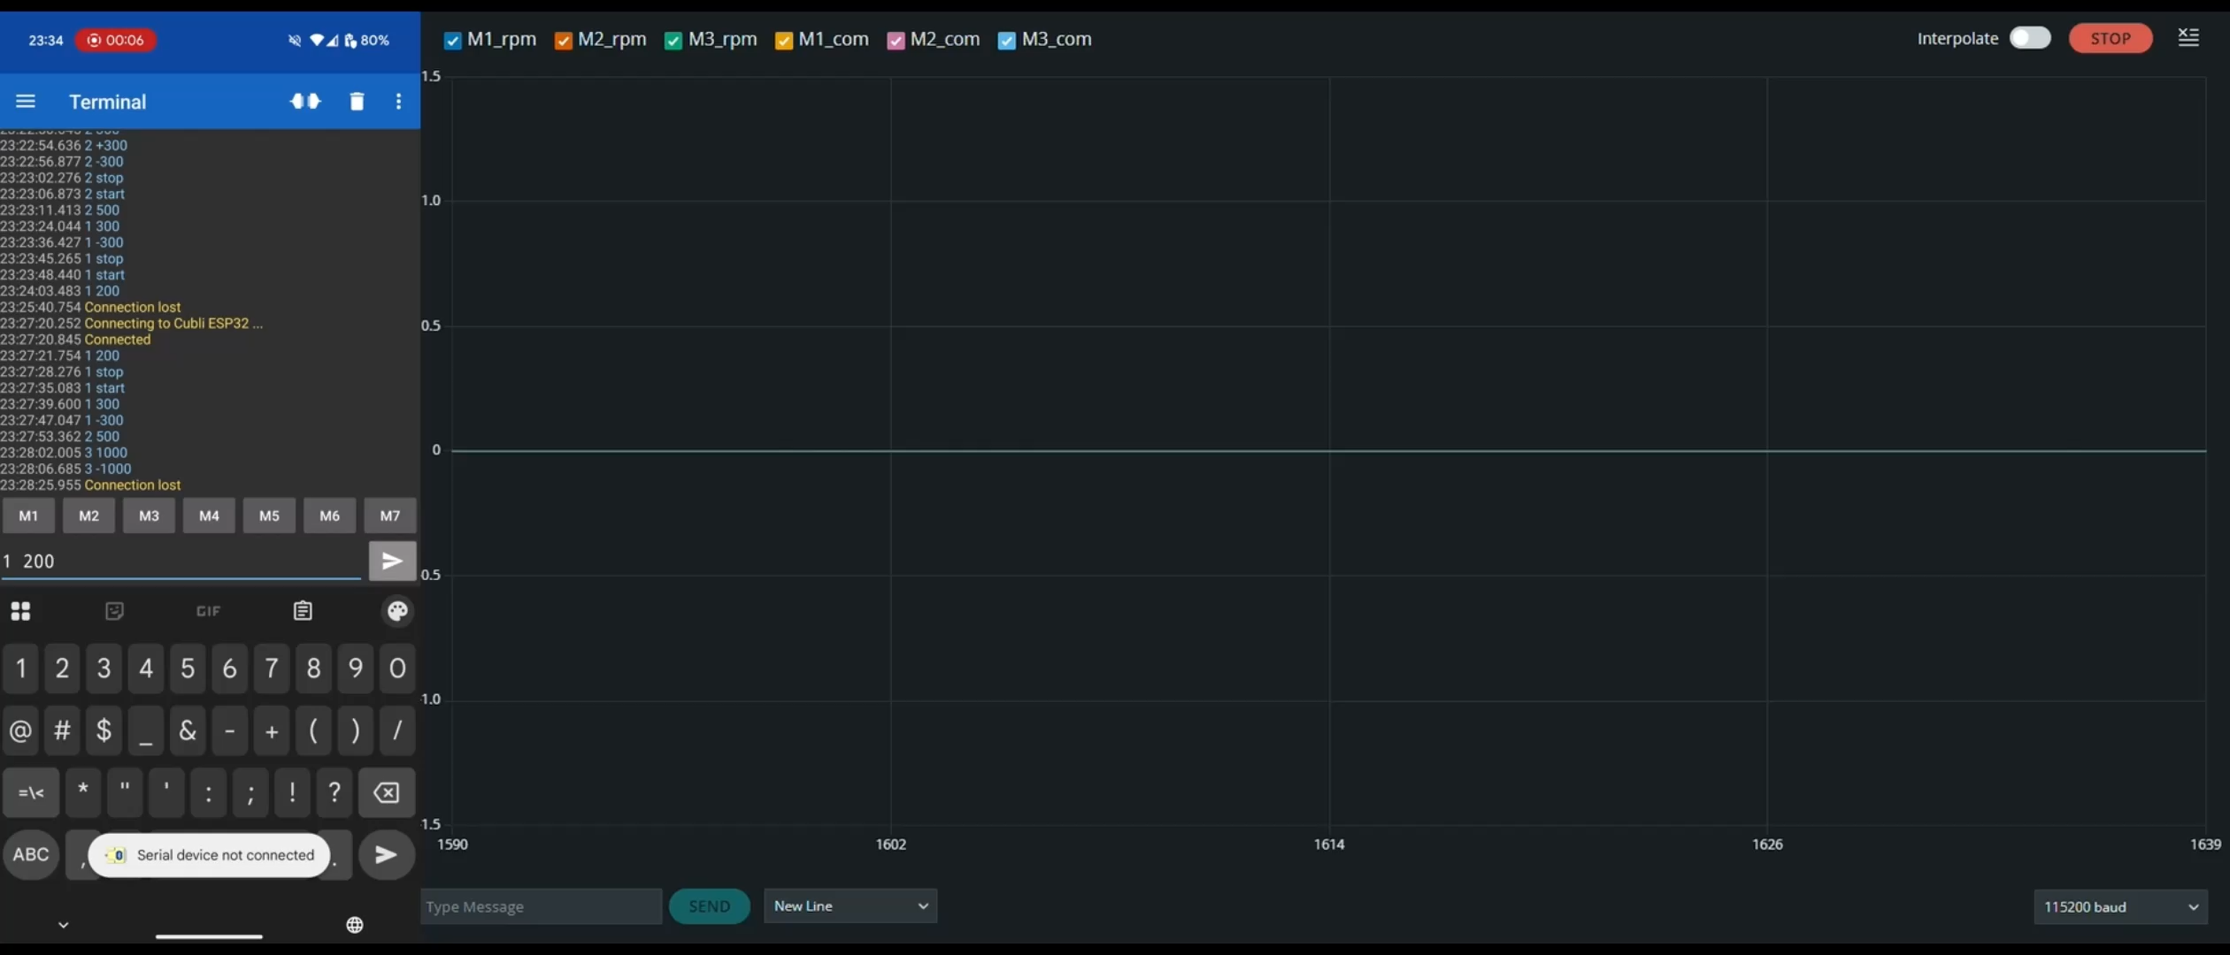
Testing

Slide 16
Next Steps
Develop the Cubli as part of the Bachelor’s thesis
Test and integrate the IMU into the control system to enable full closed-loop balancing control
Refine the 3D mechanical design to achieve a more compact structure and reduce unnecessary space
Replace 3D-printed components with precision-machined aluminum parts
Explore a more robust control strategy

Slide 17
Bibliography
ETH Zürich, Cubli: A Cube That Can Jump Up, Balance, and Walk Across Your Desk. [Online Video]. Available: https://www.youtube.com/watch?v=n_6p-1J551Y
Åström, K. J., & Hägglund, T., PID Controllers: Theory, Design, and Tuning. Instrument Society of America, 1995.
MathWorks, pidtune (PID Tuning) - MATLAB Documentation. [Online]. Available: https://www.mathworks.com/help/control/ref/pidtune.html
Texas Instruments, Brushless DC Motor Fundamentals. [White Paper]. Available: https://www.ti.com/lit/an/slyp173/slyp173.pdf
DFRobot, DF-SEN0142 MPU6050 6DOF IMU Datasheet. [Online]. Available: https://wiki.dfrobot.com
DFRobot, DFR1015 Buck Converter Module. [Product Page]. Available: https://wiki.dfrobot.com/DFR1015
Espressif Systems, ESP32 Technical Reference Manual. [Online PDF]. Available: https://www.espressif.com/en/products/socs/esp32/resources
Nidec Corporation, Nidec 24H Series Brushless DC Motor Specifications. [Datasheet]. Available: https://www.nidec.com

